Slide 1
Statistical analysis of the secondary inorganic aerosol in Hungary using background measurements and model calculations
Zita Ferenczi
Hungarian Meteorological Service

Slide 2
Overview
Secondary inorganic aerosol (formation, precursor gases, general properties)
Changes in precursor gases emissions
Long-term variability of the precursor gas concentrations
Long-term variability of the secondary inorganic aerosol concentrations
Results of the EMEP chemical transport model for SIA
Summary, future plans

Slide 3
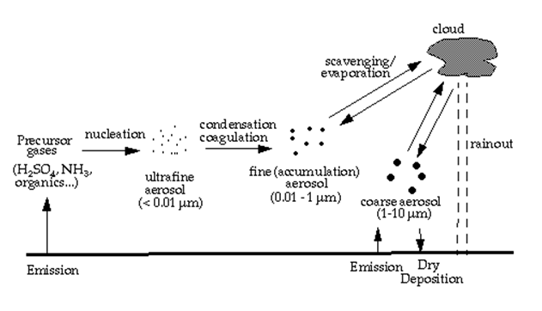
Secondary Inorganic Aerosol - SIA
Formation: result of chemical reactions or physical transformations.
Production of secondary sulfates and/or nitrates strongly depends on several chemical and micro-meteorological factors:
the levels of gaseous precursors,
the concentrations of atmospheric oxidants,
the characteristics of preexisting aerosol,
the air temperature and humidity.
SIA is almost completely of anthropogenic origin, as its precursor gases are largely emitted by traffic, energy production and agricultural sources.
Secondary aerosol concentrations do not have a linear relationship with emission levels and the cross-pollutants effects make them complicated to model and predict.
The main components of SIA are: sulfate (SO₄^{2–}), nitrate (NO₃–) and ammonium (NH₄⁺).
Precursor gases : SO₂, NO_{X}, NH₃, VOCs, OH, …

Slide 4
Why are the secondary inorganic aerosol important?
Their important role in
climate change
atmospheric visibility reduction
acidification, eutrophication
Effects on
the Earth's radiation balance
the ecosystem
the human health: variety of respiratory illnesses, cardiovascular problems and life-expectancy reduction

Slide 5
Chemical composition of the fine aerosol
The secondary inorganic aerosol (SIA) comprises on average up to 50% of the total PM mass concentrations (remarkable spatial and temporal variability)
Europe: sulfate : 11 - 35% , nitrate: 1% - 24%
USA, Los-Angeles: sulfate : 20 - 30% , nitrate: 5% - 10%
Hungary, K-puszta: sulfate : 37% , nitrate: 4%

Slide 6
Gothenburg Protocol
Emission reduction commitments
Convention Party |  | Gothenburg Protocol | SO₂ | NO_{x} | NH₃ | VOC | PM_{2,5} | Base year
Hungary | 2020 | 2012 | 46% | 34% | 10% | 30% | 13% | 2005
 | 2010 | 1999 | 46% | 17% | 27% | 33% | - | 1990
European Union | 2020 | 2012 | 59% | 42% | 6% | 28% | 22% | 2005
 | 2010 | 1999 | 75% | 49% | 15% | 57% | - | 1990

Slide 7
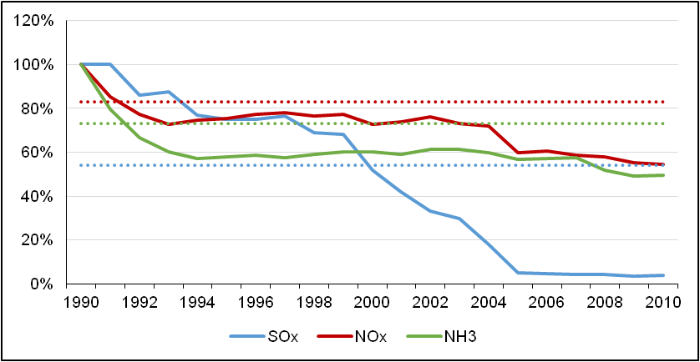
Long-term variability of the precursor gases emissions in Hungary (1990-2010)
National emission ceilings
from the Gothenburg Protocol

Slide 8
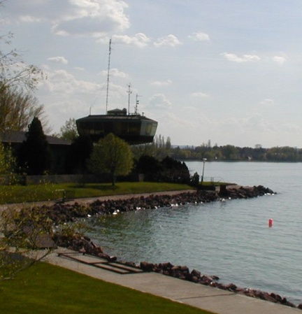
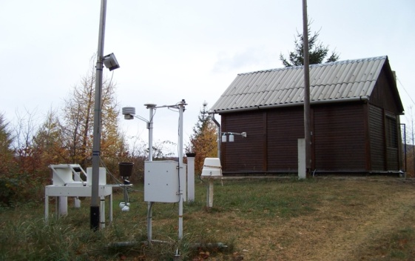
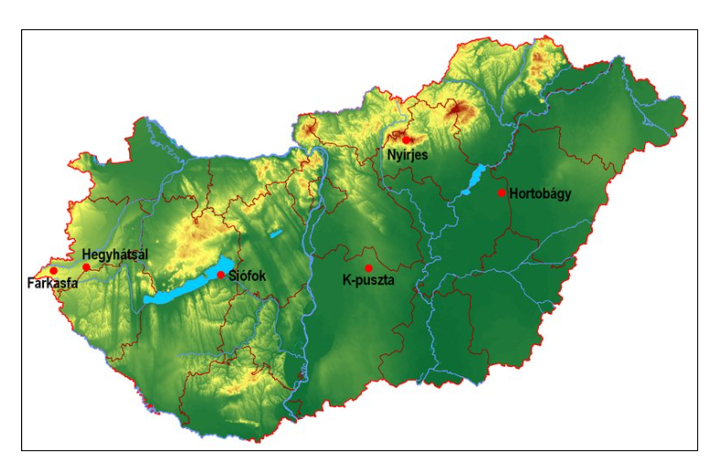
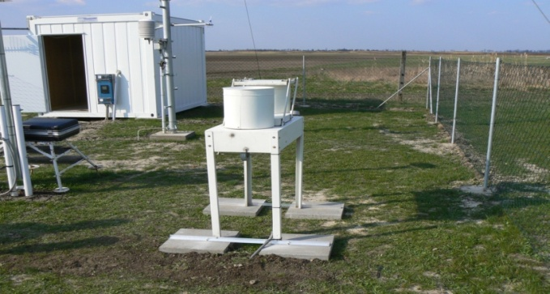
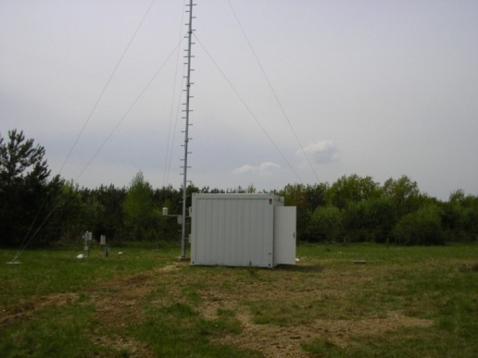
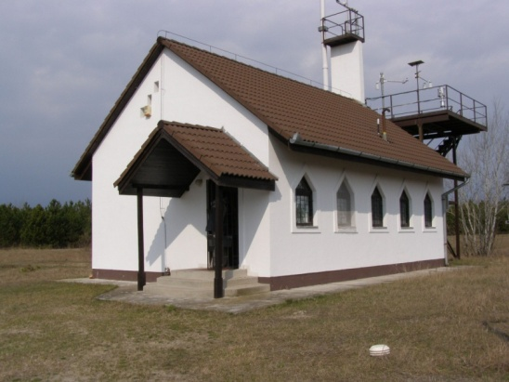
Background Air Pollution Monitoring Network of Hungary

Slide 9
Monitoring program of K-puszta
Trace gases:
SO₂, NO₂, O₃, NH₃, HNO₃
Aerosol:
sulfate, nitrate, ammonium, sodium, potasium,
calcium, magnesium, heavy metals , PM₁₀, PM_{2.5}
Inorganic compounds in precipitation:
pH, conductivity, sulfate, nitrate, ammonium, chloride, sodium, magnesium, calcium, potassium, heavy metals
K-puszta is our reference station, member of the EMEP and WMO/GAW networks
The monitoring program of this station is the widest
The measurement at K-puszta started: SO₂ 1973
NO₂ 1974

Slide 10
Monitoring program of Farkasfa and Nyírjes stations
The measurement started on these stations: 1996
Trace gases:
SO₂, NO₂, O₃, NH₃, HNO₃
Aerosols:
sulfate, nitrate, ammonium, sodium, potasium, calcium, magnesium, heavy metals
Inorganic compounds in precipitation:
pH, conductivity, sulfate, nitrate, ammonium, chloride, sodium, magnesium, calcium, potassium, heavy metals

Slide 11
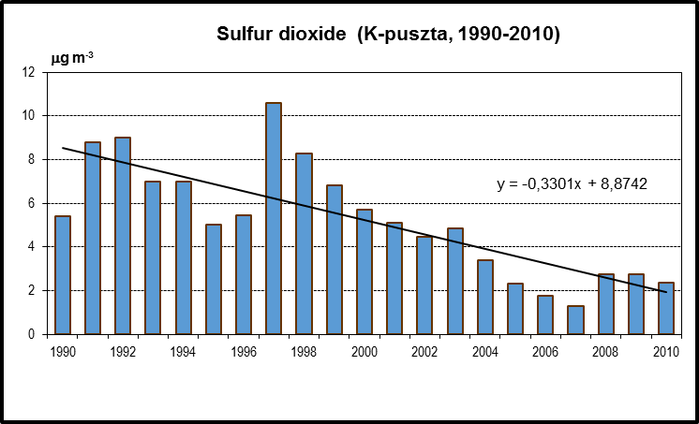
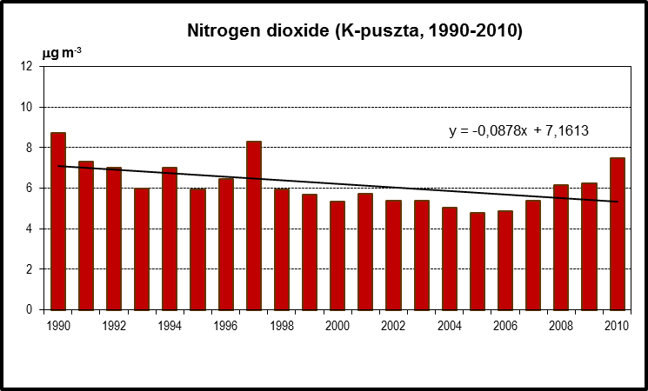
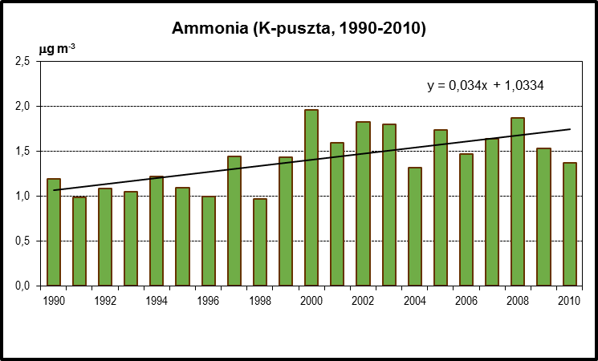
Temporal variability of yearly average of SO2, NO2 and NH3 concentrations at K-puszta station (1990 -2010)

Slide 12
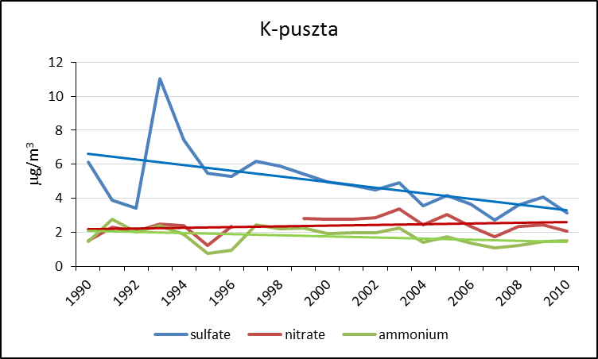
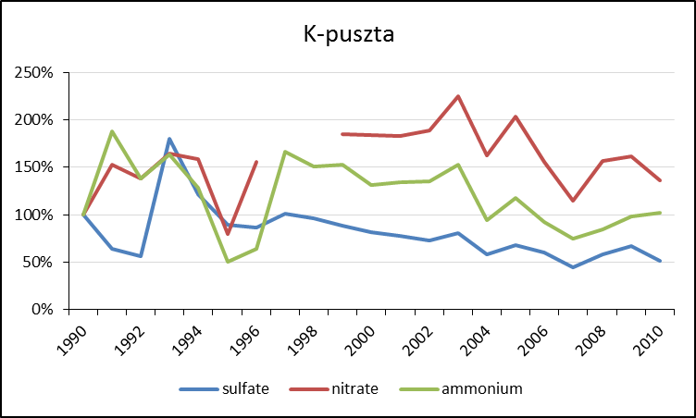
Temporal variability of yearly average concentrations of main ions in the secondary inorganic aerosol at K-puszta station (1990 -2010)
Concentration values
Percent of the variability

Slide 13
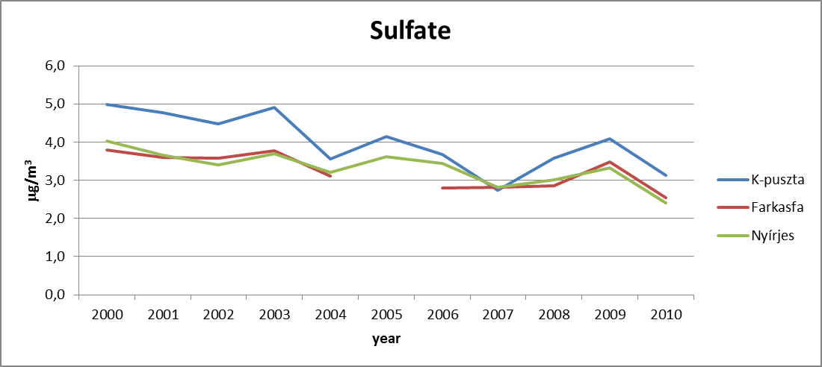
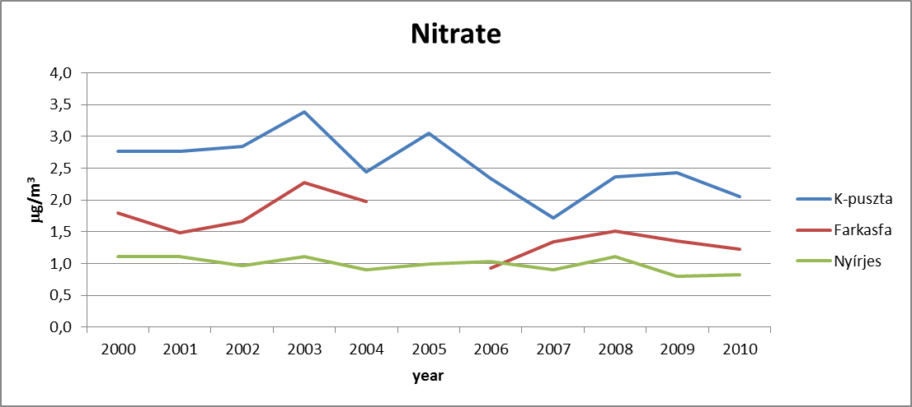
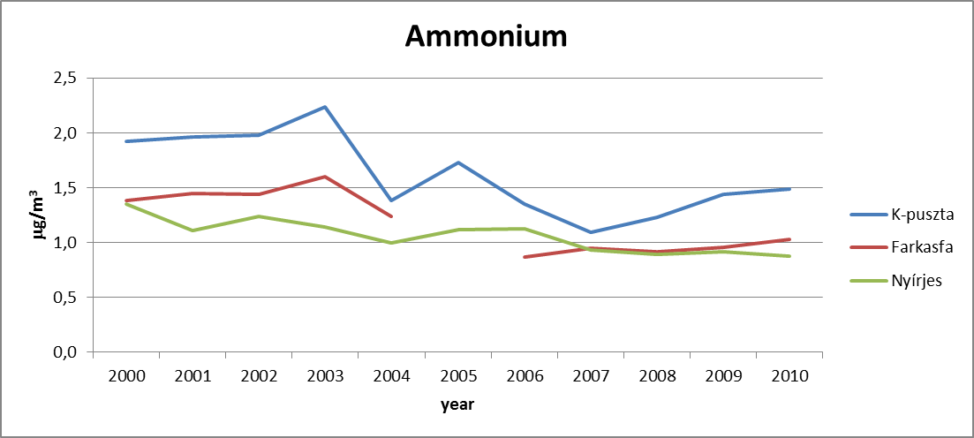
Temporal variability of yearly average SIA concentrations at the background stations of Hungary (2000-2010)

Slide 14
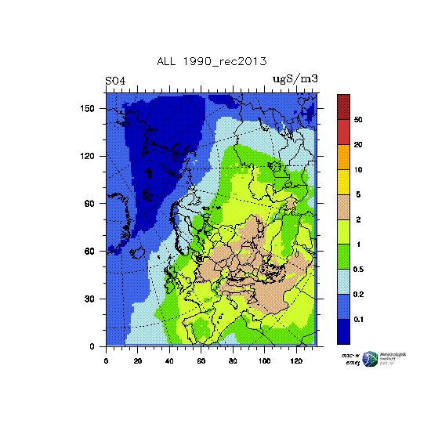
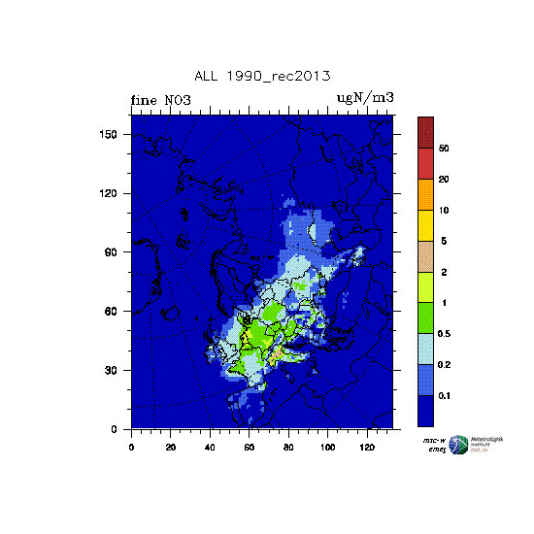
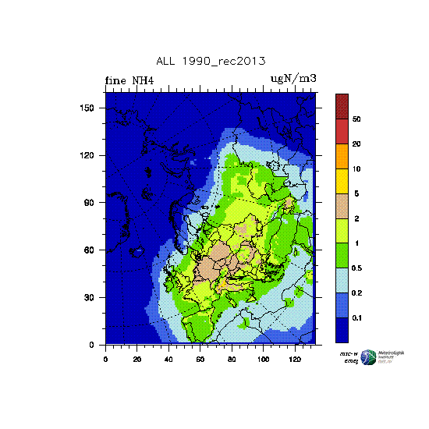
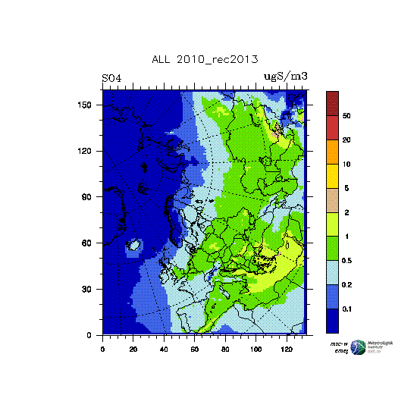
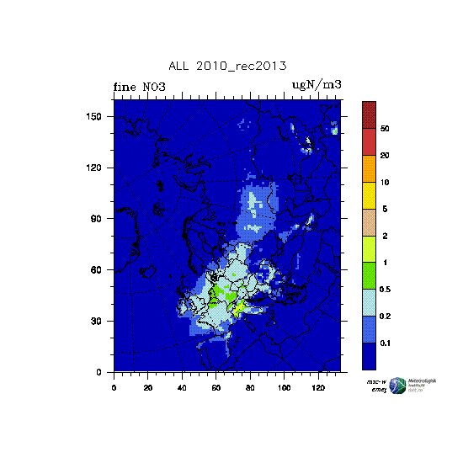
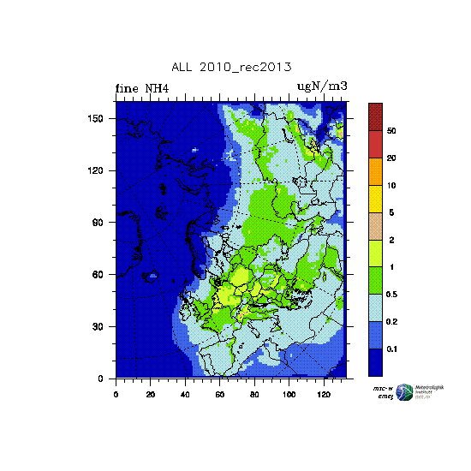
EMEP model calculation results for SIA (1990 and 2010)
SO₄^{2–}
NO₃–
NH₄⁺
1990
2010

Slide 15
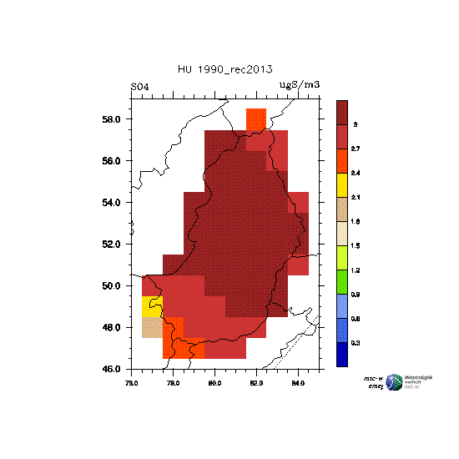
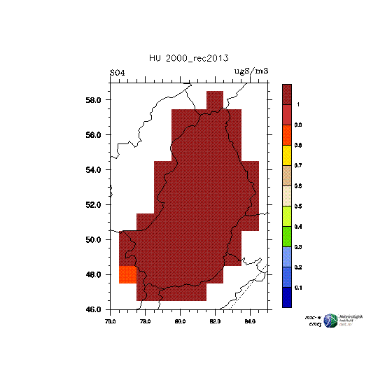
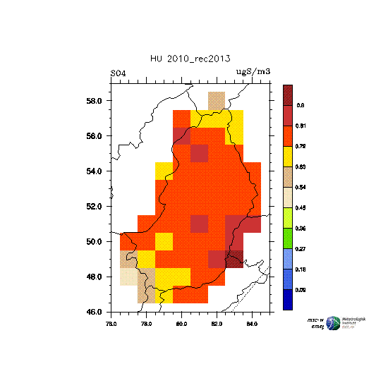
EMEP model calculation results for Hungary: SO₄^{2–}
1990
2000
2005
2010
Max: 3.0 μgS/m³
Min: 0.3 μgS/m³
Max: 1.0 μgS/m³
Min: 0.1 μgS/m³
Max: 1.0 μgS/m³
Min: 0.1 μgS/m³
Max: 0.8 μgS/m³
Min: 0.09 μgS/m³

Slide 16
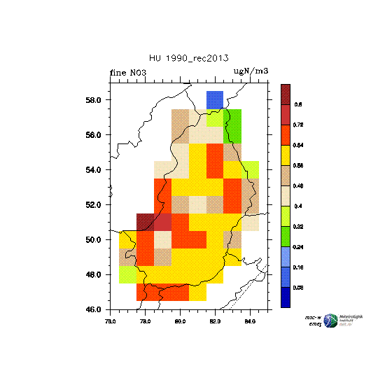
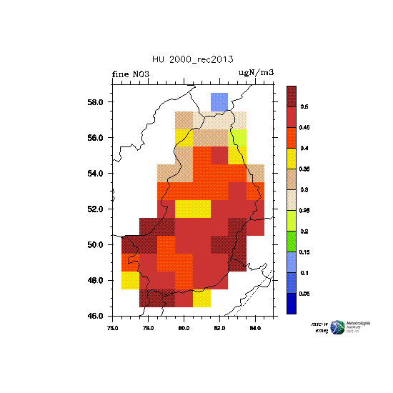
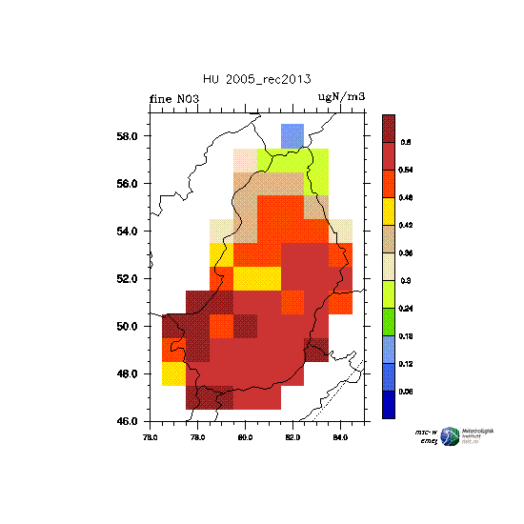
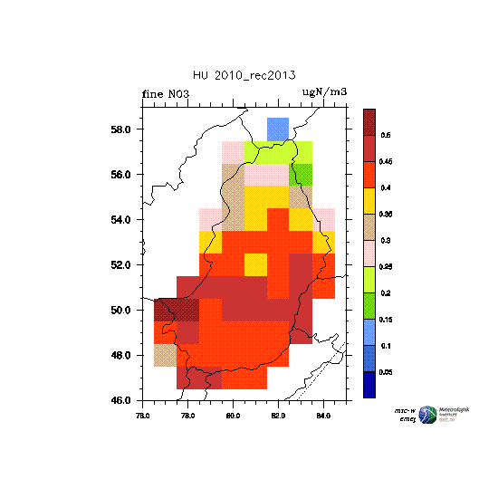
EMEP model calculation results for Hungary: NO₃–
1990
2000
2005
2010
Max: 0.8 μgN/m³
Min: 0.08 μgN/m³
Max: 0.5 μgN/m³
Min: 0.05 μgN/m³
Max: 0.6 μgN/m³
Min: 0.06 μgN/m³
Max: 0.5 μgN/m³
Min: 0.05 μgN/m³

Slide 17
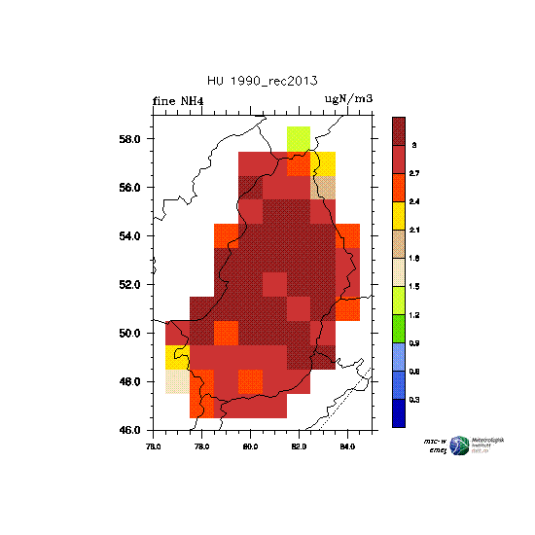
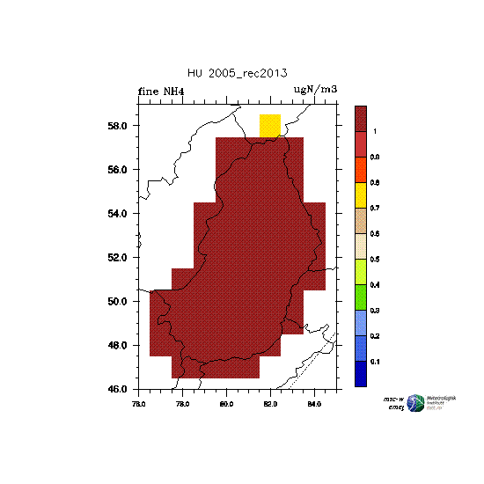
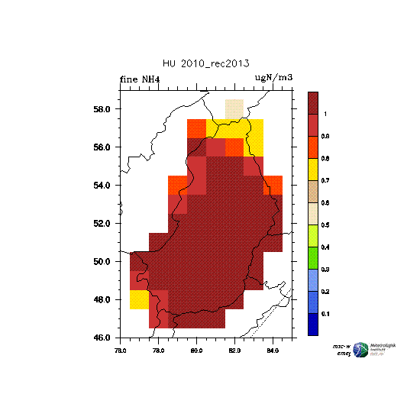
EMEP model calculation results for Hungary: NH₄⁺
1990
2000
2010
2005
Max: 3.0 μgN/m³
Min: 0.3 μgN/m³
Max: 1.0 μgN/m³
Min: 0.1 μgN/m³
Max: 1.0 μgN/m³
Min: 0.1 μgN/m³
Max: 1.0 μgN/m³
Min: 0.1 μgN/m³

Slide 18
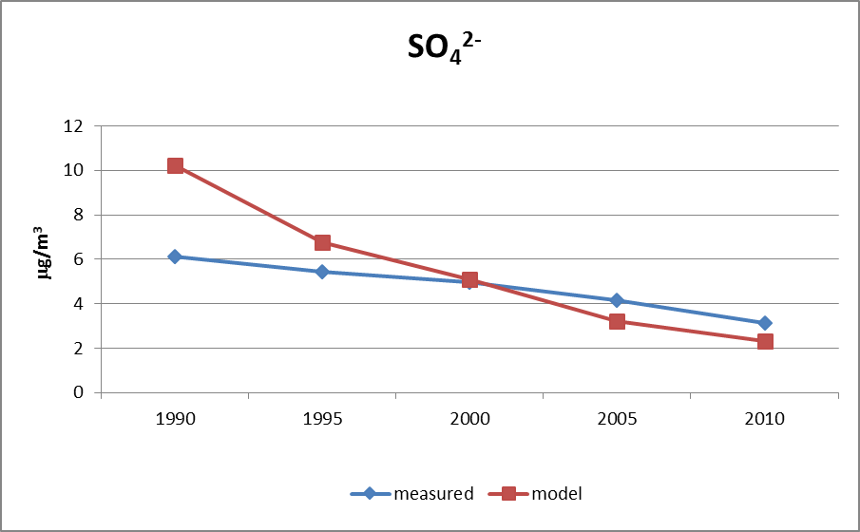
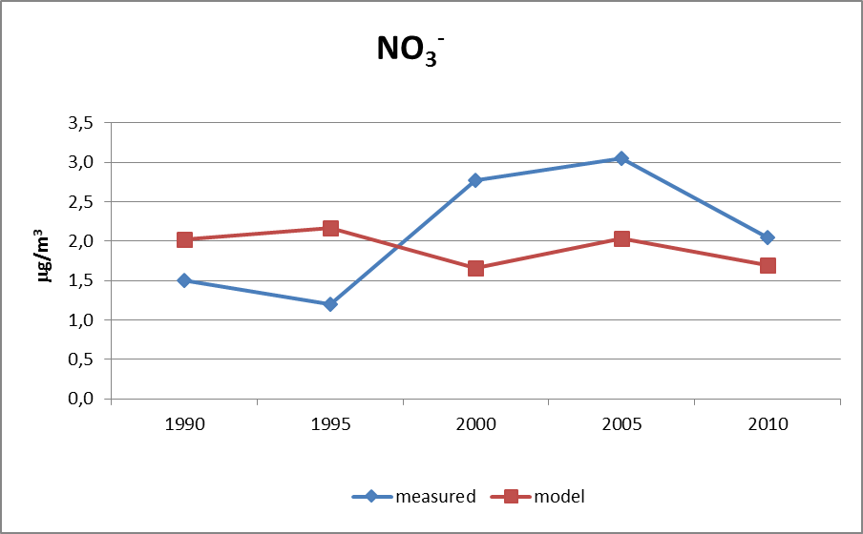
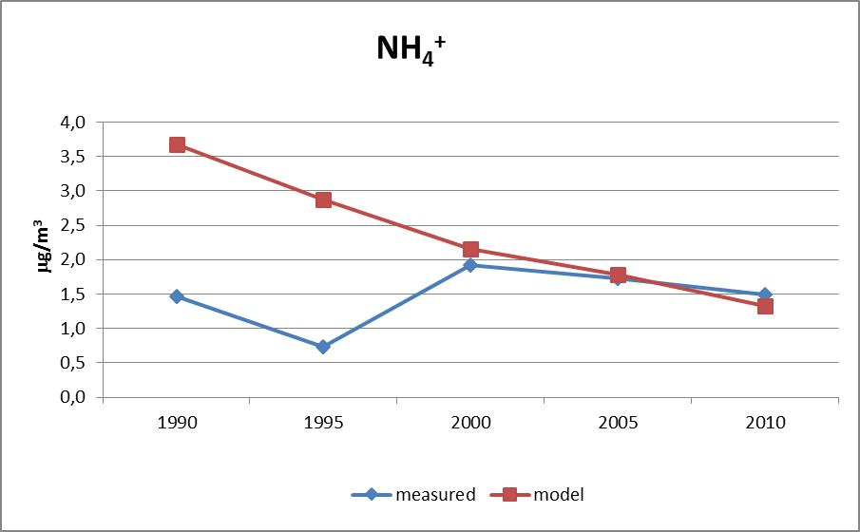
EMEP model results versus measurements: K-puszta

Slide 19
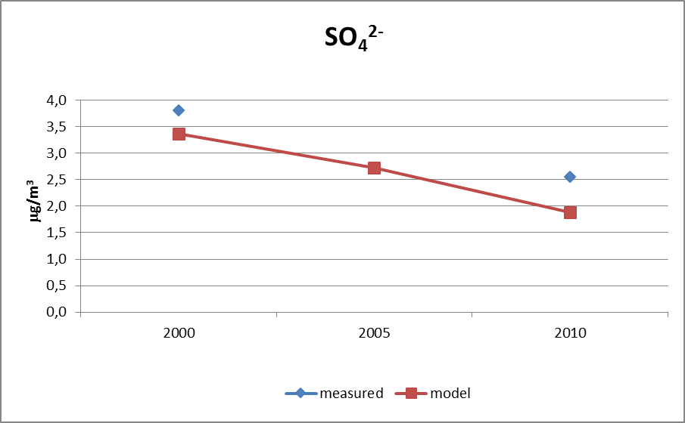
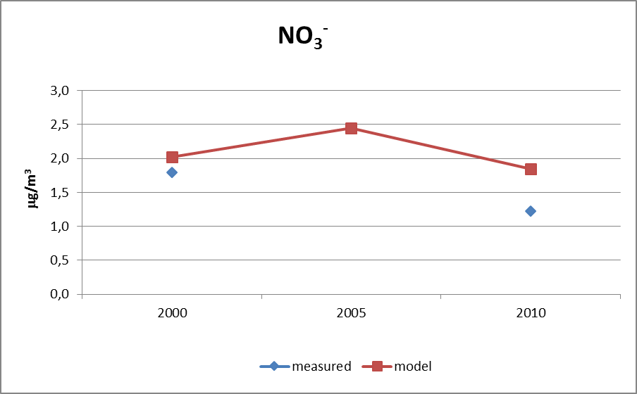
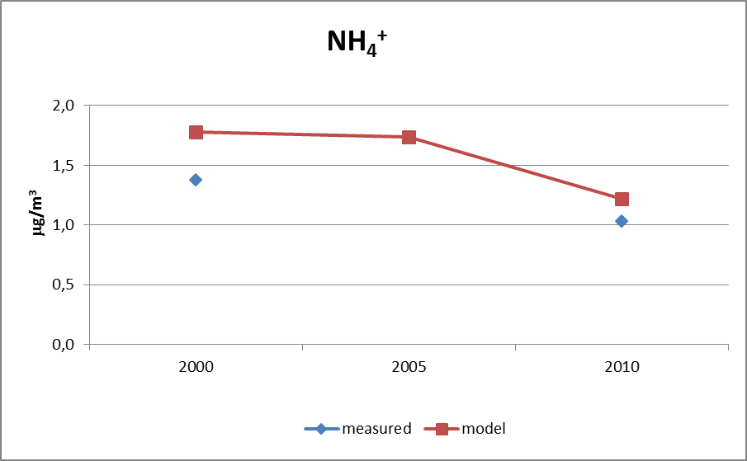
EMEP model results versus measurements : Farkasfa

Slide 20
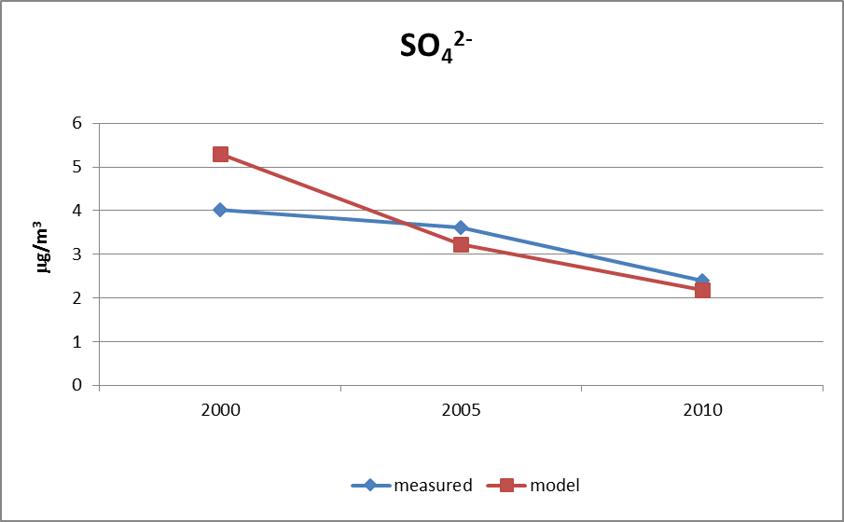
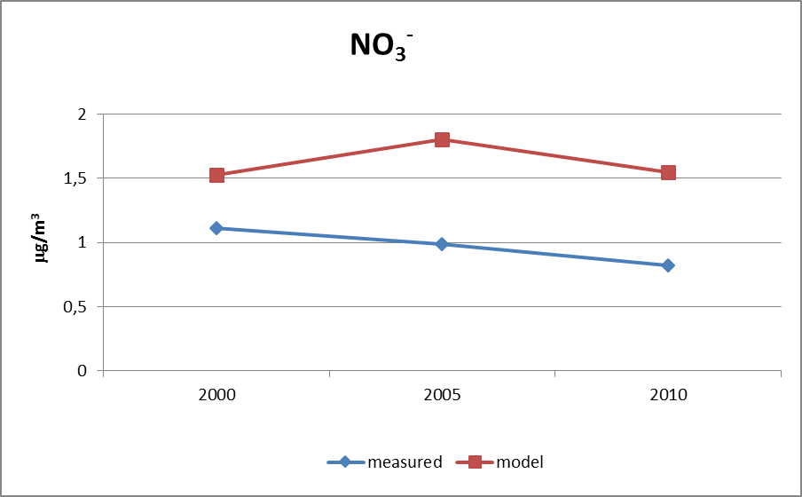
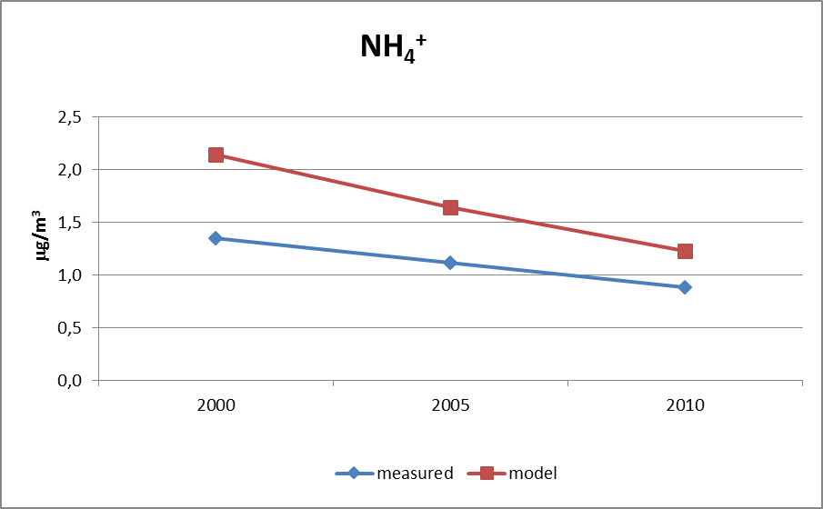
Model results versus measurements : Nyírjes

Slide 21
Summary, future plans
Conclusions
Changes in the period of 1990-2010 :
precursor gases emission: SO₂: -96%, NO_{x}: -46 %, NH₃ : -51%
precursor gases concentration:
SO₂ and NO₂ concentration decreased
in spite of the reduction of NH₃ emission, the concentration of ammonia did not decrease
The reduced SO₂ concentration decreases the rate of conversion of NH3 to ammonium-sulfate, and the ammonia remains in the gas phase (1990-2000)
After 2000 the emission of SO2 did not change significantly, the concentration of NH3 did not increase further, the concentration of ammonium begins to decrease
Results of the EMEP model:
In case of K-puszta the behaviour of the model compared to the measured data is inverse before 2000 and after 2000,
In case of ammonium and sulfate the measured and calculated values are close to each other for all three station in Hungary,
In case of nitrate the model over predicts the measured values for Farkasfa and Nyírjes stations, but for K-puszta the model under predicts the measured values,
Questions: What are the representativeness of the measurements in case of the stations?
How reliable are the emission data?
Future plans:
Identification of sources
Investigate the role of meteorological parameters

Slide 22
Thank you for your attention!

